Slide 1

Circular Flow of Income
Macroeconomics

Slide 2
What is Macroeconomics ?
The study of the structure and performance of national economies and of the policies that governments use to try to affect economic performance.
Main issues in Macroeconomics
long-run economic growth
economic activities to fluctuate
unemployment
inflation
government policies

Slide 3
Basic framework of an economy and Circular Flow of Income
The circular flow of income is illustrated in the circular flow model of an economy, which is one of the most significant basic models of economics.
This model shows how different economic agents of an economy interact, breaking things down in a highly simplified manner.
The circular flow of income demonstrates how economists calculate national income or Gross Domestic Product (GDP).
GDP is the total monetary or market value of all the finished goods and services produced within a country in a specific time period.”

Slide 4
Basic framework of an economy and Circular Flow of Income
There are many ways to look into the Circular Flow of Income Model.
Two Sector model
Three Sector model
Four Sector model and so on.
First we will discuss the two sector model.
Firms: The firm sector includes businesses that take on the risk of combining scarce resources to produce goods and services. This sector buys capital goods with investment and pays for the factors of production
Household: The household sector is responsible for consumption expenditure.

Slide 5
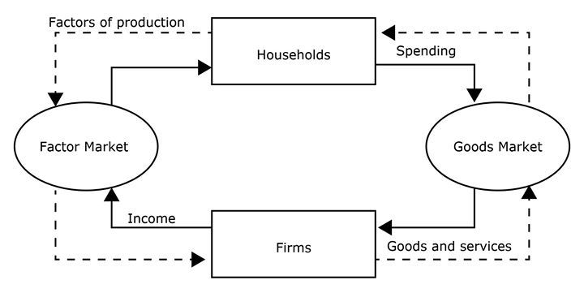
Basic framework of an economy and Circular Flow of Income
Two Sector model
1
3
Land
Labour
Capital
Entrepreneurship
1
2
2
Money flow
Wage, rent, interest, profit, payment for goods and services
1
1
3
Real activity in the economy
&
2
2

Slide 6
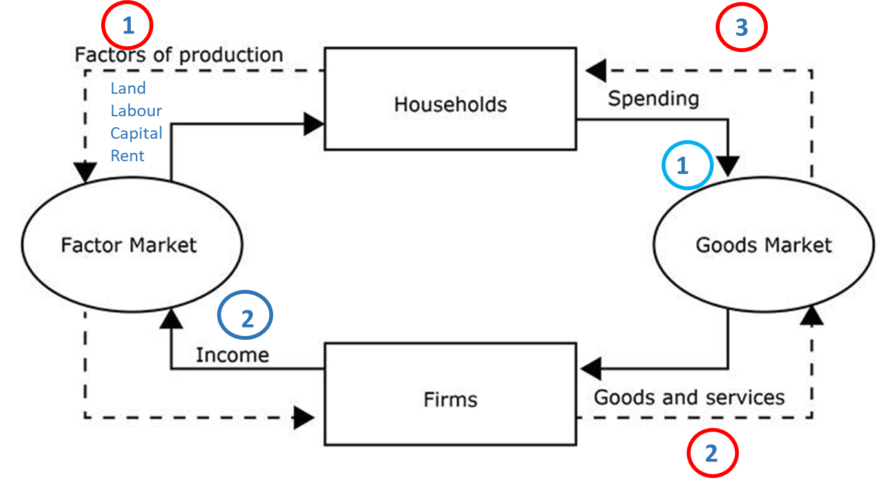
Basic framework of an economy and Circular Flow of Income
Three Sector model
Entrepreneurship
Subsidies
Public good
Taxation
Government
Taxation
Infrastructure
Public good
Three Sector model,
Household
Firms
Government
1
1
Money flow
Wage, rent, interest, profit, payment for goods and services
3
Real activity in the economy
&
2
2

Slide 7
Basic framework of an economy and Circular Flow of Income
Four Sector model,
Household
Firms
Government
External sector (Export import)
Four Sector model, External economy or trade
Entrepreneurship
Taxation
Subsidies
Public good
Government
Taxation
Infrastructure
Public good
Labour and capital
Goods and services
Inputs, technology
Factors of production like labour, capital
Export
In return they gets remittances
External Sector
Consumption goods
Import

Slide 8
Basic framework of an economy and Circular Flow of Income
Five Sector model, Financial Institution
1
Savings
5
Financial Sector
Investment
2
Five Sector model
Household
Firms
Government
External sector (Export import)
Financial Sector and Central Banks
3
Government
4
Export
External Sector
Import

Slide 9
Circular Flow of Income and Macroeconomics
In terms of the five sector circular flow of income model the state of equilibrium occurs when the total leakages are equal to the total injections.
Savings + Taxes + Imports = Investment + Government Spending + Exports
S + T + M = I + G + X
Disequilibrium can be shown as
S + T + M ≠ I + G + X
If S + T + M > I + G + X, the levels of income, expenditure and employment will fall causing a recession or contraction in the economic activity.
If S + T + M < I+ G + X the levels of income, expenditure and employment will rise causing a boom.

Slide 10
References:
N. Gregory Mankiw, Macroeconomics, Worth Publishers, 9th ed., 2016.
Olivier Blanchard and David R. Johnson, Macroeconomics, Pearson, 7th ed., 2017

